Slide 1

PROJECT TITLE
PRODUCT DATA MANAGEMENT OF ENGINE OIL DRAINER USING TEAMCENTER
SECOND REVIEW
Roll No/Student Name
20BME002 / NAVANEETHAN S
20BME012 / JESMOND FRANC R
Guide Name
Dr. S. MADHUSUDHANAN
AP/(SG)

Slide 2
CONTENTS
INTRODUCTION
METHODOLOGY
OBJECTIVE
LITERATURE SURVEY
DETAILED DESIGN USING NX-CAD
TEAMCENTER
MANUFACTURING PROCESS
REFERENCES

Slide 3
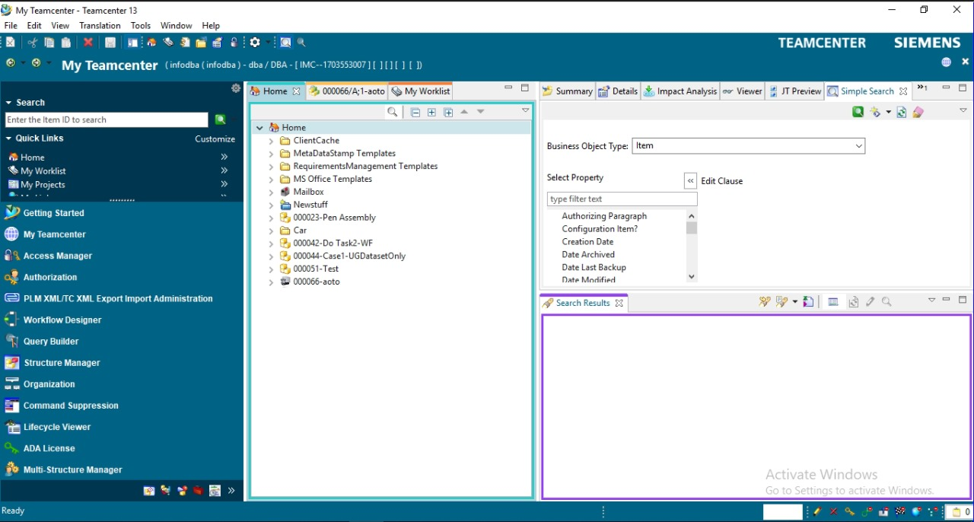
INTRODUCTION
In the process of servicing the two-wheelers, one of the time-consuming processes is draining the used Engine Oil. It usually takes a few minutes to drain completely with the help of gravity.
This increases the time and thereby decreases the productivity of mechanics.
To give a solution for this above problem, we have developed a prototype named Engine Oil Drainer.
In this process of developing a prototype involves saving CAD files, assigning tasks, making variants, and other processes with the help of PLM software named Teamcenter.
Using this software, we can able to track our progress, manage data, creating a Bill of Materials thereby increasing our productivity in finishing a project at a faster rate .

Slide 4
METHODOLOGY
Title Selection
Cost Analysis
Component Purchasing
Material Selection

Slide 5
Designing
Integrating with Teamcenter
Manufacturing
Assembly
Testing

Slide 6
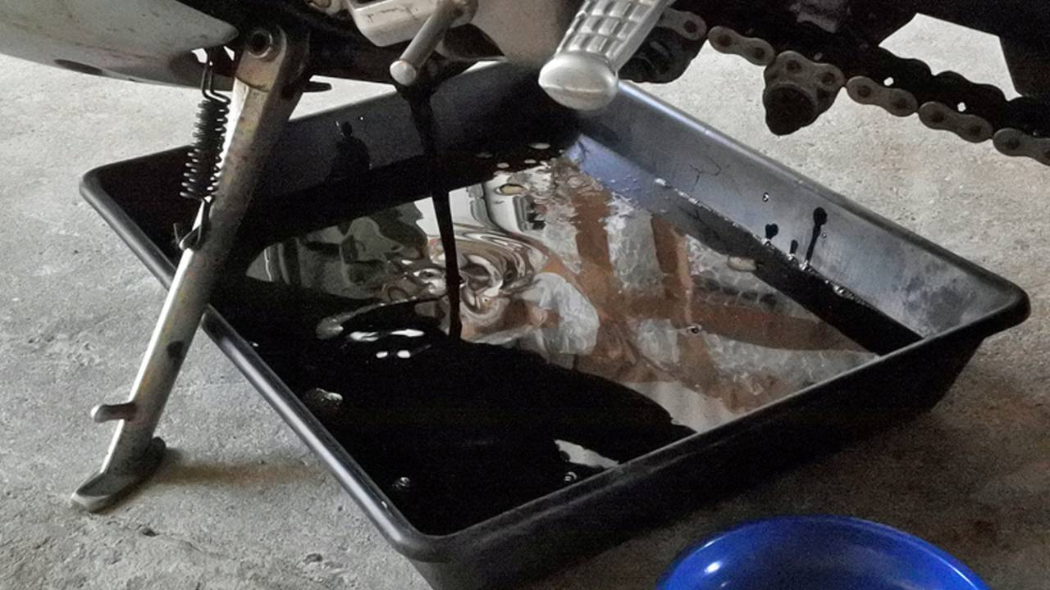
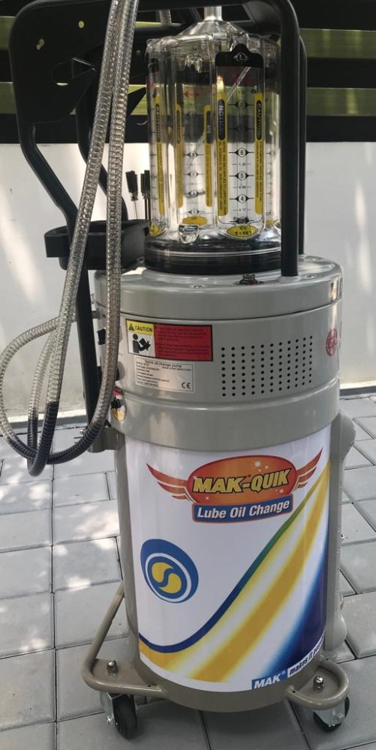
OBJECTIVES
The main objective of the Engine Oil Drainer is to reduce the time
of draining the used Engine oil.
It increases the productivity of mechanics to service the bikes at a
very faster rate.
Existing models only have a suction process which involves the use
of pneumatics.
We have added a vacuum pump to create a vacuum inside
Engine block and suction pump are used to completely drain the
oil in addition to gravity.

Slide 7
LITERATURE REVIEW
S.NO​ | AUTHOR​ | PAPER JOURNAL​ | DESCRIPTION​ | LINKS​
1.​ | Shrikant Baliram Pokale,​ Sawan Sakharam Borul,​ M.K.Rodge​ | Client Side Customization for Checking User Rights in Teamcenter-PLM​ | Talks about client-side customization and allotting user rights for user safety.​ | https://citeseerx.ist.psu.edu/document?repid=rep1&type=pdf&doi=8e1cf3a0b9a23603177e2947a274fd228b7c4cf6​
2.​ | Jaykumar Yoga Mule​ | PLM based Customization for Extraction of NX Assembly from Team center to Local Drive​ | Talks about extraction of NX assembly from Teamcenter to Local Drive.​ | https://research.ijais.org/volume2/number6/ijais12-450381.pdf​ ​

Slide 8
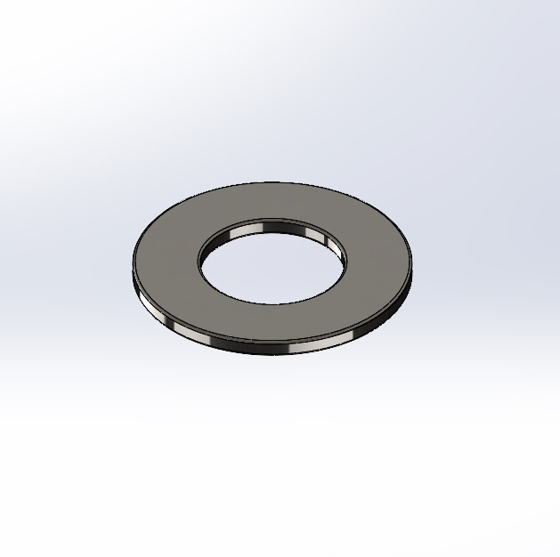
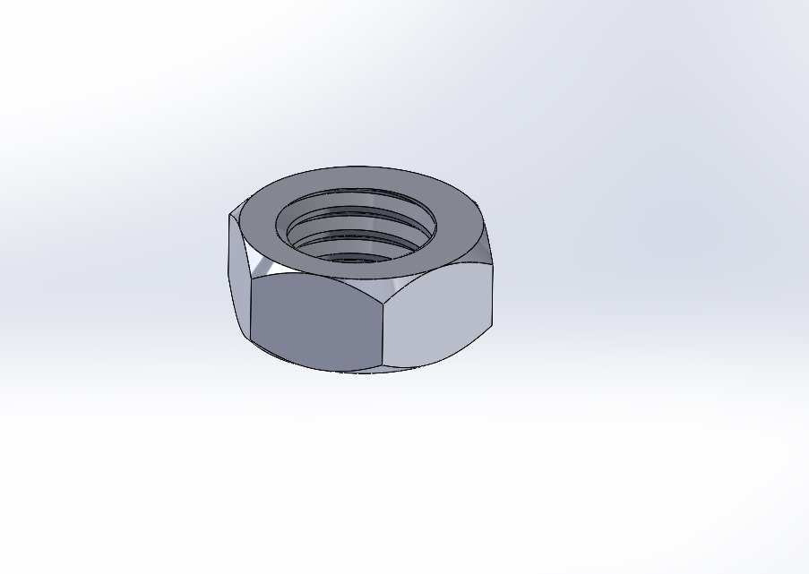
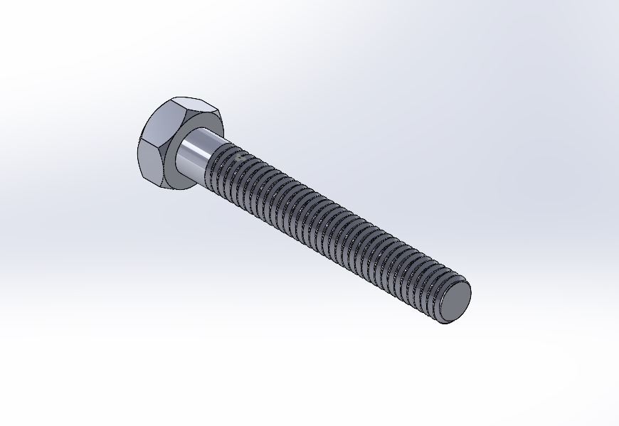
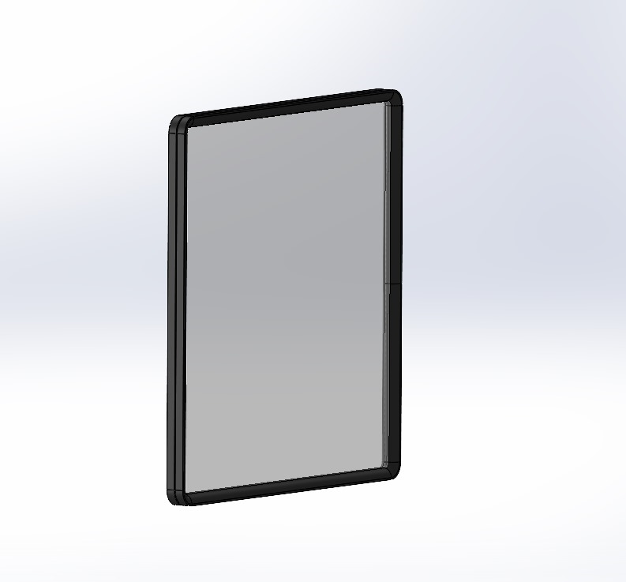
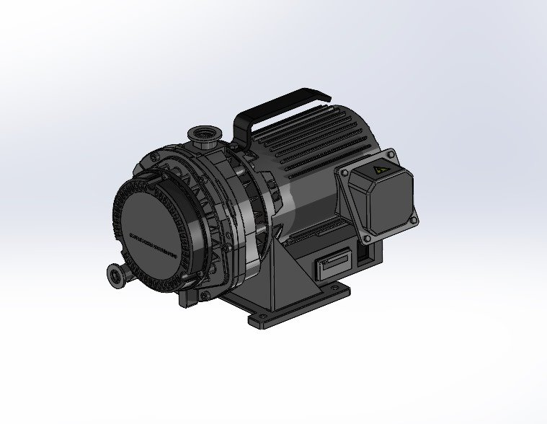
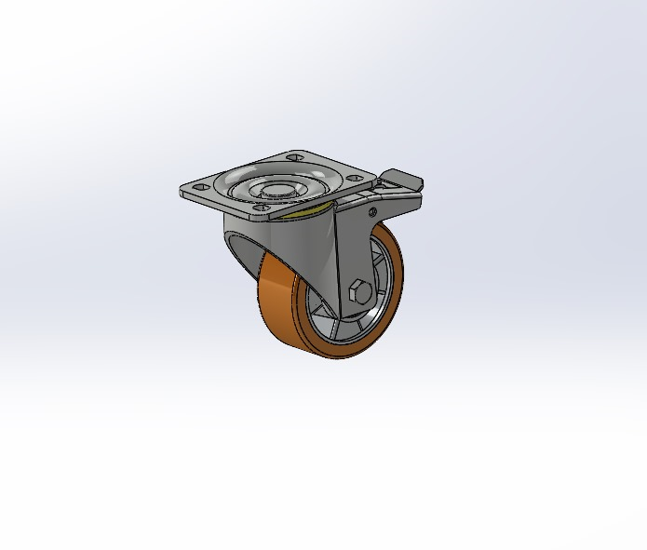
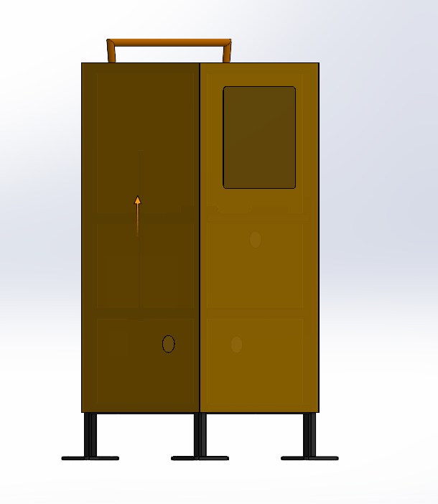
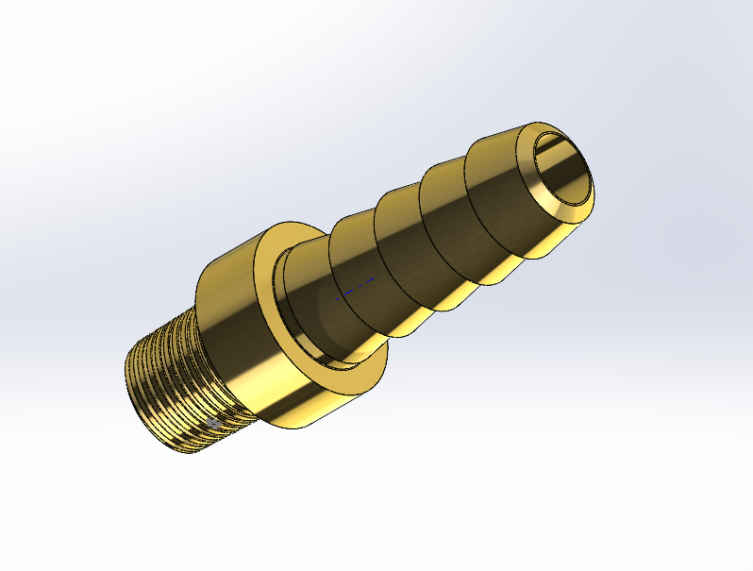
DETAILED DESIGN USING NX-CAD
The required components have been designed in NX software for Integration with Teamcenter.
Washer
Nut
Bolt
Rubber Beading with Glass
Vacuum Pump
Roller Assembly
Outer Structure
Brass Nipple

Slide 9
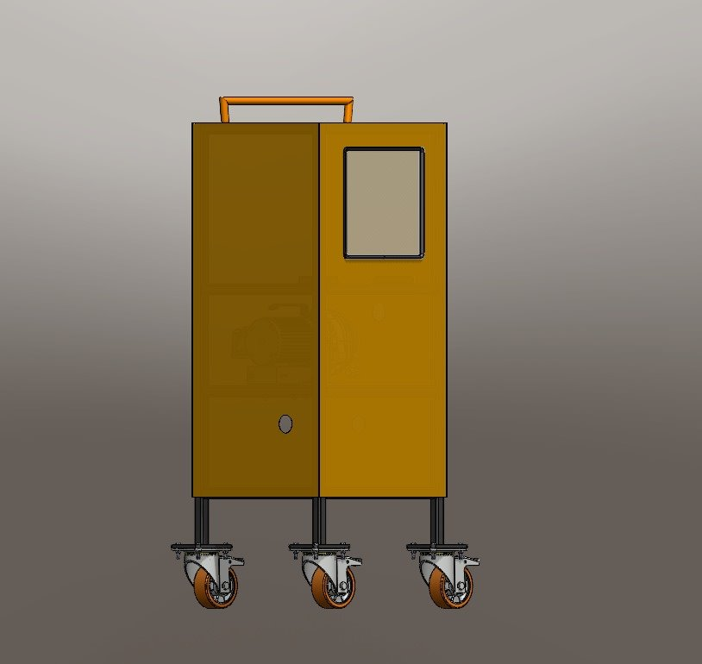
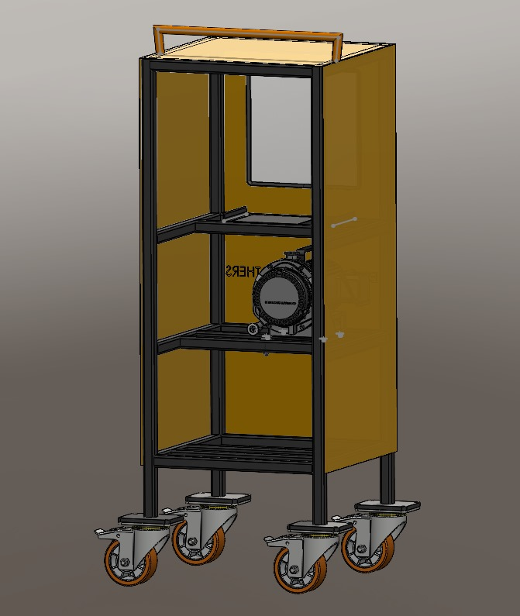
70% of Assembly has been completed and pictures below shows the Isometric View and Rear View of Engine Oil Drainer
Isometric View
Rear View

Slide 10
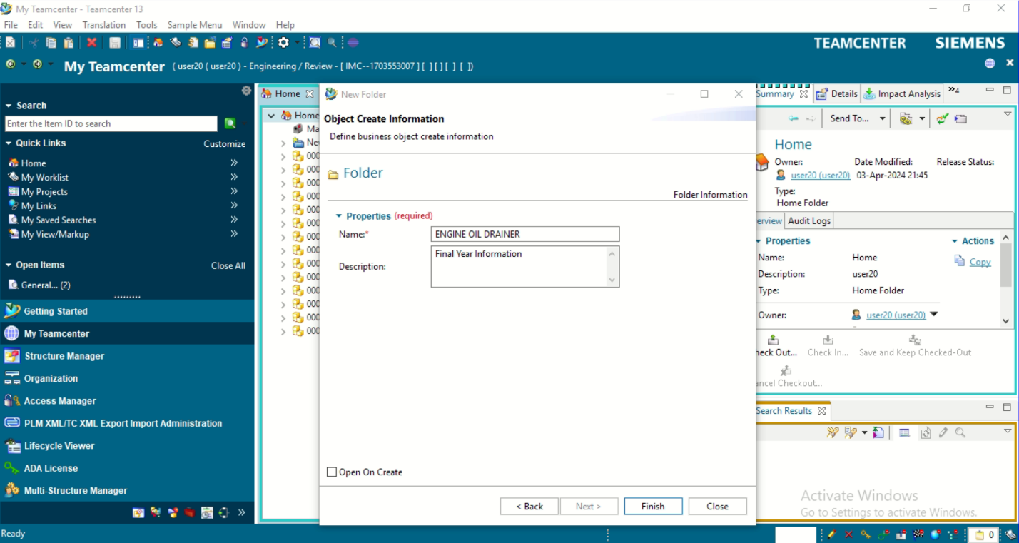
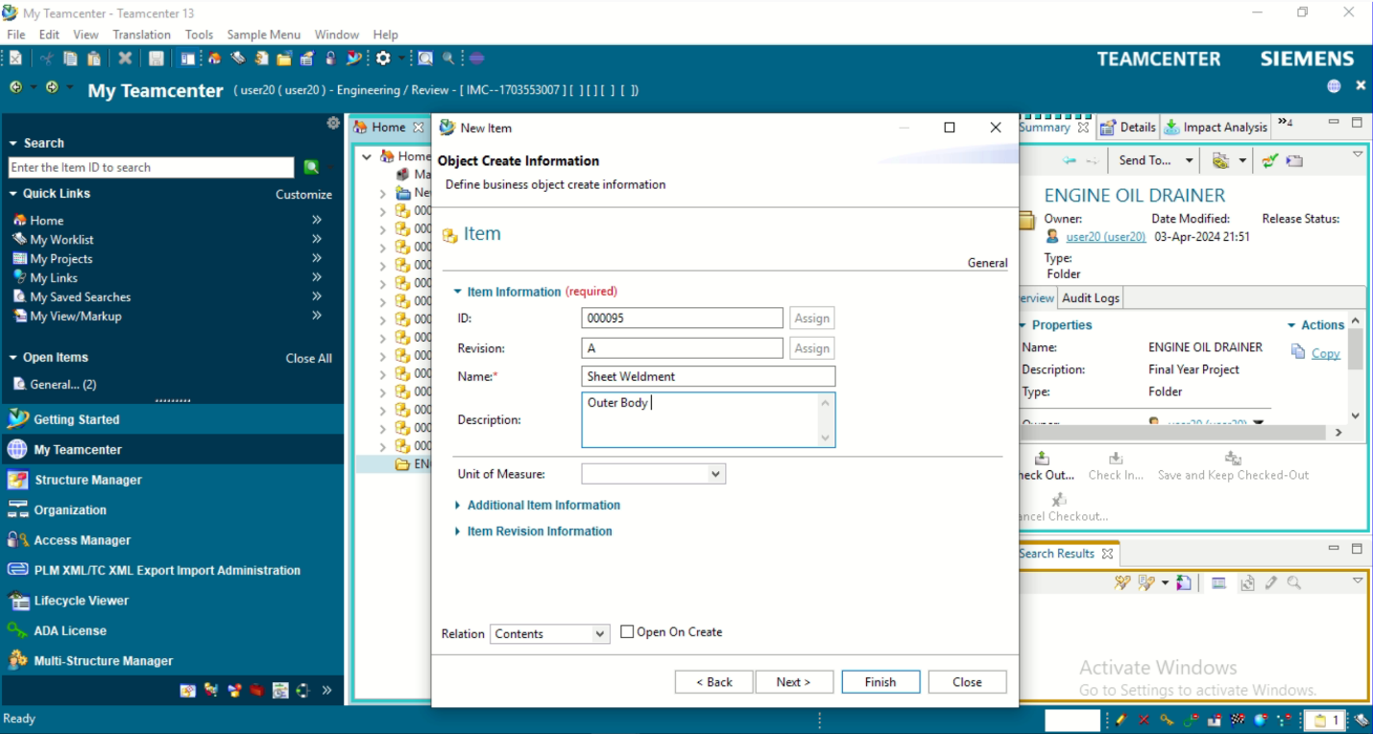
TEAMCENTER PROGRESS
Creating a Project Folder in Teamcenter
Creating items for each components

Slide 11
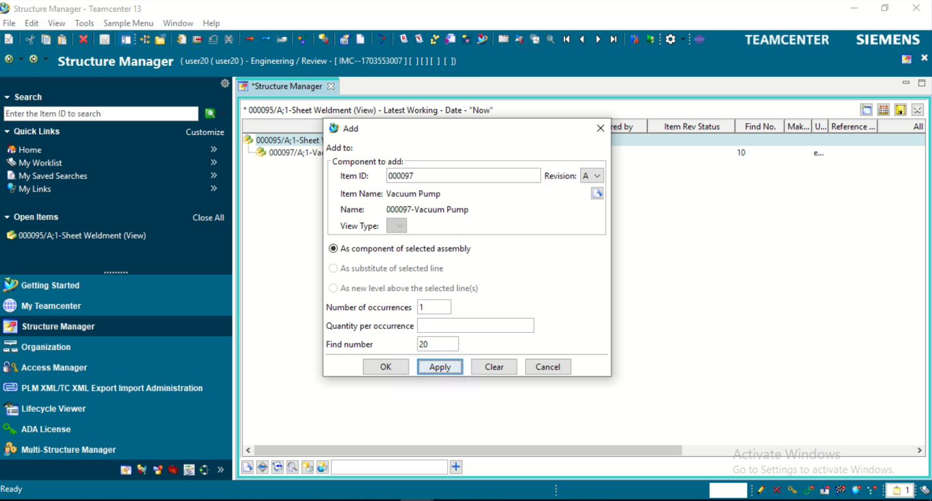
Creating a Structure Manager for our Project

Slide 12
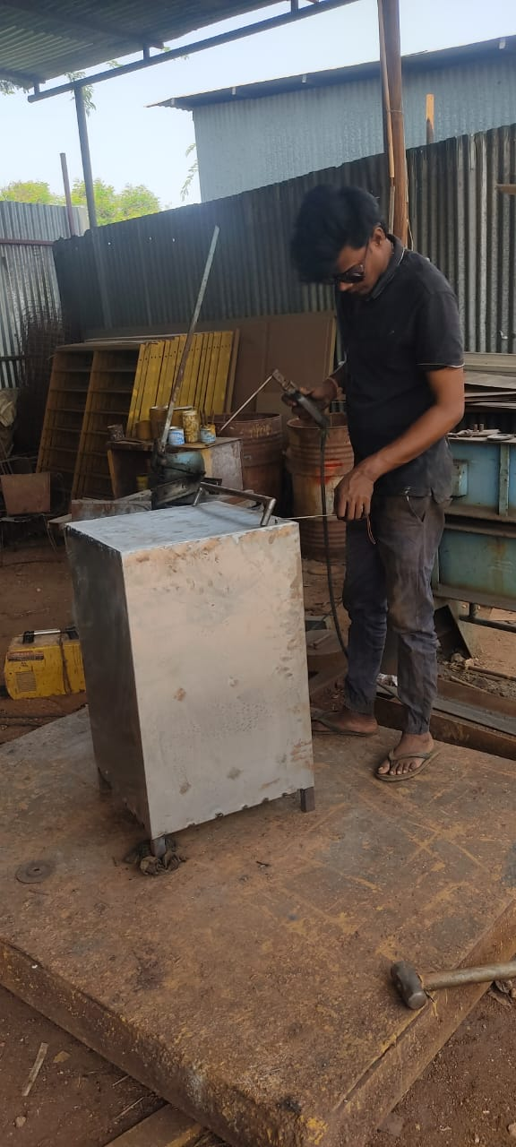
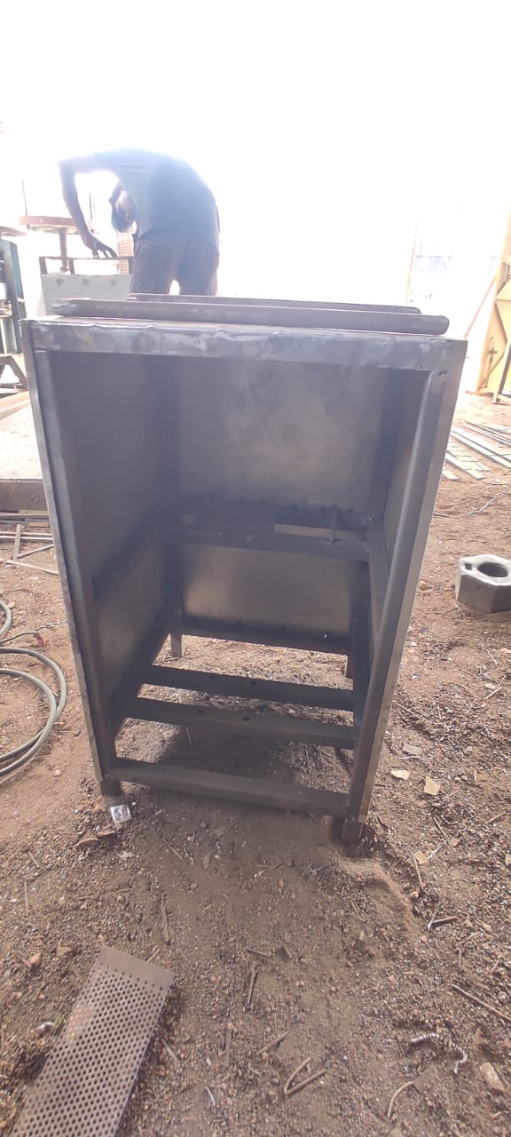
MANUFACTURING PROCESS
Outside View
Inside view with holes and mountings

Slide 13
REFERENCES
Mr. Narangale Digvijay Dhondiram “Customization of BMIDE at Customer End as per Business Requirement” Journal on IISRD (International Journal of Trend in Scientific Research and Development),2021, Vol 5(3), pp. 44-49​
https://www.slideshare.net/YogeshIJTSRD/customization-of-bmide-at-customer-end-as-per-business-requirement​
2. Siemens Xccelerator Academy ​
https://training.plm.automation.siemens.com/index.cfm
3. PLM-based Customization for Extraction of NX Assembly from Team center to Local Drive
https://research.ijais.org/volume2/number6/ijais12-450381.pdf

